Slide 1
International Trade and the Propagation of Merger Waves
Muhammad Farooq Ahmad SKEMA Business School - Université Côte d’Azur
Eric de Bodt NHH (Norwegian School of Economics) and Caltech
Jarrad Harford Foster School of Business at the University of Washington China
Institute of Economics and Finance, Fudan University, and ECGI
Presented by Austin Francis

Slide 2
Research Question
Does international trade (the flow of goods and services between countries) help spread merger waves across borders?
Notes:
A merger wave happens when there is a surge in mergers and acquisitions (M&A) within certain industries or countries. The paper wants to see if countries that trade a lot with each other experience similar surges in mergers—in other words, they are testing if a merger wave in one country can influence another country through trade relationships.

Slide 3
Prior Literature
Cross-border mergers: Rossi and Volpin (2004) show that cross-border acquisitions are influenced by firm productivity, local financial conditions, and geographical proximity.
Role of Trade and Culture: Ahern et al. (2015) emphasize that cultural factors and specific industry-level trade relationships significantly influence domestic and international mergers.
M&A Network Effects: Previous research by Ahern and Harford (2014) reveals that industry-level trade networks play a crucial role in domestic U.S. merger activities.
Notes:
Relationship lenders often acquire private information about borrowers, creating an information asymmetry that makes it costly for borrowers to switch lenders. This allows relationship lenders to increase loan spreads and hold up borrowers
Potential outside lenders face a winner’s curse when competing to lend to a borrower with an incumbent lender, as the outside lenders are less informed
Borrowers respond to information asymmetry by publicly sharing information, which reduces loan spreads by increasing lender competition

Slide 4
Hypothesis
The paper suggests that international trade relationships act as a transmission channel for mergers.
Notes:
In simple terms: if Country A does a lot of trade with Country B, and there is a wave of mergers in Country A, then Country B is likely to experience a similar merger wave due to their strong trade ties.
They want to prove that trade flows don’t just reflect goods moving between countries — they also spread business practices and economic trends, like mergers.

Slide 5
Key Metrics
Trade-Weighted Merger Activity (Connected M&A): This is a new measure the authors use to see how much a country’s merger activity is influenced by the merger activity of its trade partners. They do this by "weighting" (or adjusting) the merger activity in other countries based on how much those countries trade with the country being studied.
Notes:
If Country A imports a lot from Country B, then Country B’s merger activity will have a stronger impact on Country A’s merger activity, and vice versa.
It’s calculated by weighting the merger activity in one country by how much it trades with other countries. For example, if the U.S. has a lot of mergers happening and it trades heavily with Mexico, the U.S. merger wave could influence Mexico, creating a higher chance of mergers happening there.

Slide 6
Key Metrics
High M&A State: This is a term to indicate when the country is experiencing a lot of mergers at a given time. The paper divides merger activity into periods of high and low states. They are interested in predicting when a country will be in this high state based on what is happening in countries it trades with.
Notes:
This means that a country is in a period where mergers are happening more than usual. For each country, they define a "high M&A state" as the years where merger activity is in the top 25% of all its years.

Slide 7
Results
Trade spreads merger waves.
Imports seem to drive this effect more than exports.
Notes:
Countries that trade a lot with others are more likely to experience similar merger activity when their trade partners go through a merger wave.
In other words, countries importing a lot from a partner experiencing a merger wave are more likely to have mergers

Slide 8
Data Collection
The trade data comes from the UN ComTrade database
Merger data comes from Thomson Financial’s SDC data set
Control variables from Datastream database

Slide 9
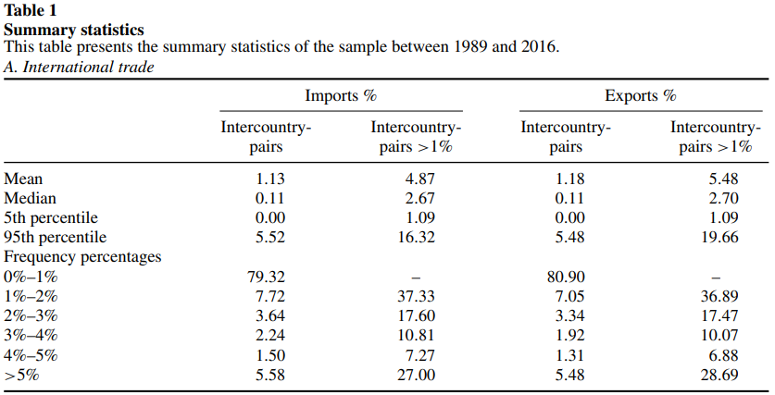
Table 1 – Summary Statistics
Notes:
Trade Relationships: On average, country pairs accounted for 1.18% of exports, with some reaching up to 19.66%. For imports, the average was 1.13%.
Cross-Border Mergers: There were 49,905 cross-border mergers across the sample, with 174,899 domestic mergers.
Sparse Merger Networks: 62% of country pairs did not engage in cross-border mergers, suggesting that merger activity is concentrated among certain trade partners.
Data is from 1989 to 2016

Slide 10
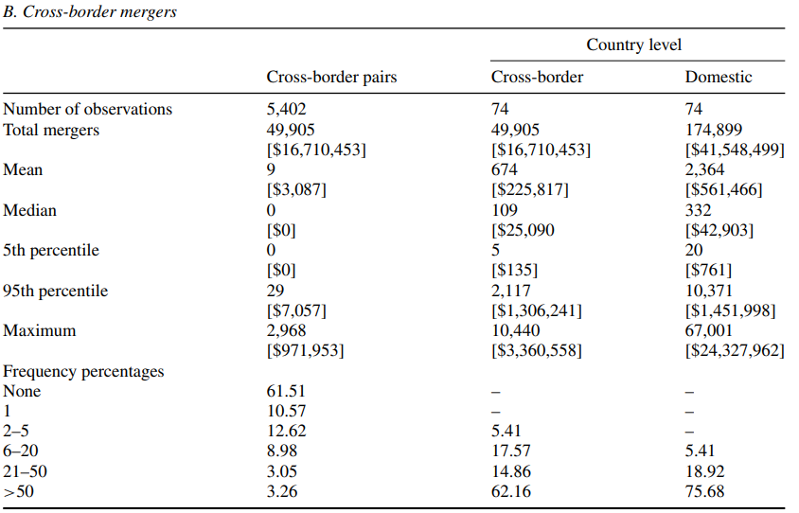
Table 1 – Summary Statistics
Notes:
Trade Relationships: On average, country pairs accounted for 1.18% of exports, with some reaching up to 19.66%. For imports, the average was 1.13%.
Cross-Border Mergers: There were 49,905 cross-border mergers across the sample, with 174,899 domestic mergers.
Sparse Merger Networks: 62% of country pairs did not engage in cross-border mergers, suggesting that merger activity is concentrated among certain trade partners.

Slide 11
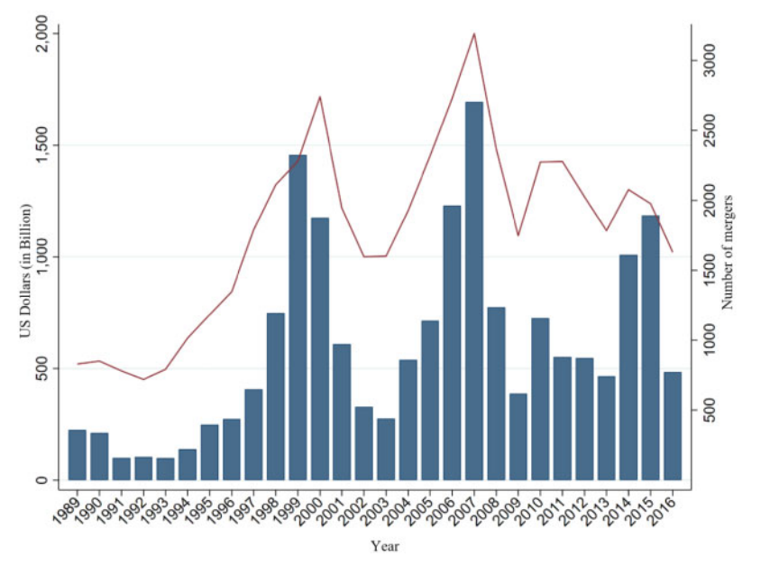
Cross-Border Mergers
Notes:
International merger waves, follows the well documented American merger wave

Slide 12
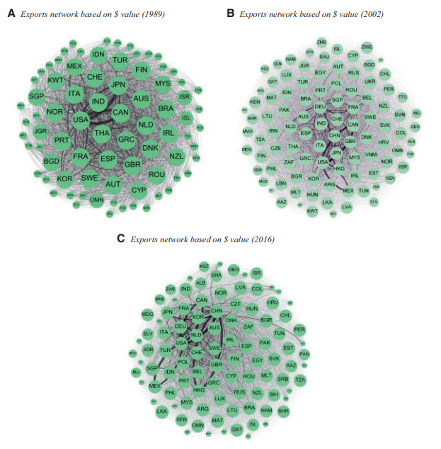
Export Network – All countries

Slide 13
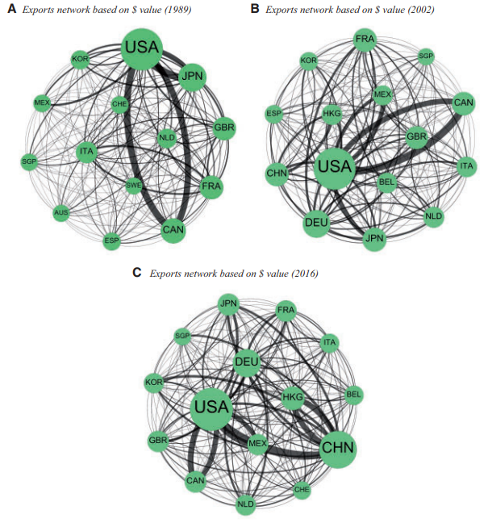
Network of Top 15 Most Central Countries – Exports

Slide 14
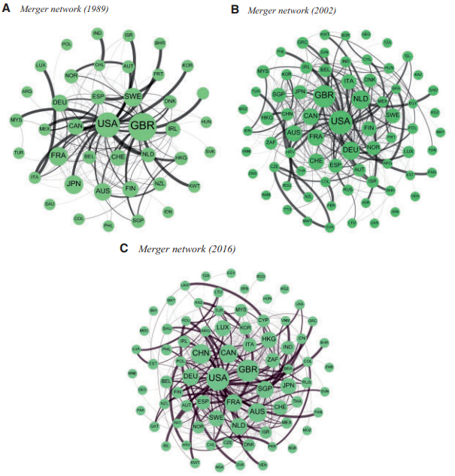
Merger Network

Slide 15
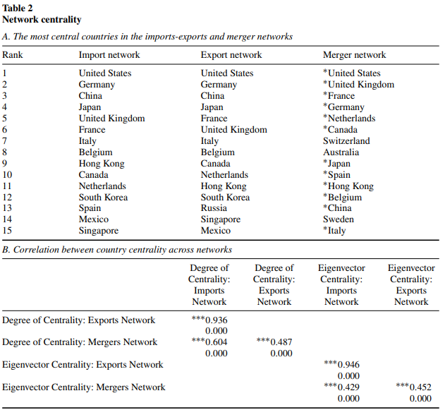
Table 2 – Network Centrality
Notes:
Centrality highly correlates with the imports network, and merger network.

Slide 16

Empirical Design
Notes:
ConnectedM&A, is the trade-weighted merger activity in connected countries. We use information from the entire network of trade data, weighting merger activity in each country (the nodes) by the amount of trade they do with the subject country (their edges connecting them to the subject country).
where i and j are the subject and connected country, respectively, t is the year, Wi,j,t is a weighting term based on trade flows between i and j in year t, and M&Aj,t is the measure of M&A intensity in country j and year t (either countbased or value-based, depending on the weighting scheme adopted to compute the dependent variable5). For each country i and at each time period t, four ConnectedM&Ai,t variables can be computed, depending on the trade flows used to compute Wi,j,t :

Slide 17
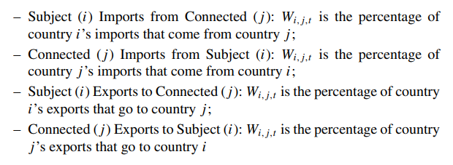
Empirical Design
4 Different measures of Connected M&A

Slide 18

Empirical Design

Slide 19
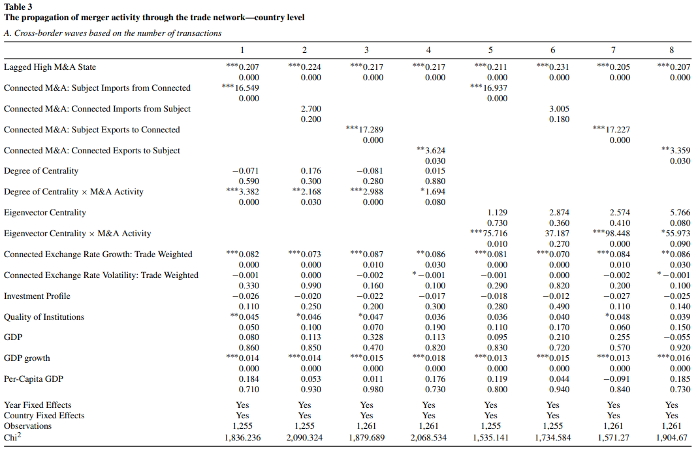
Notes:
Dependent Variable = High M&A State. Panel A = Cross Border Panel b = Domestic all measures of trade-weighted M&A activity load positively (and three of the four are significant) for explaining a High M&A State. The effects are strongest (both in terms of coefficient values and statistical significance) for Subject Imports from Connected and Subject Exports to Connected.
Cross-border mergers are mergers between companies from different countries. For example, if a company in the U.S. acquires a company in Germany, that would be a cross-border merger.Domestic mergers are mergers between companies from the same country. For instance, if two U.S. companies merge, that is a domestic merger.

Slide 20
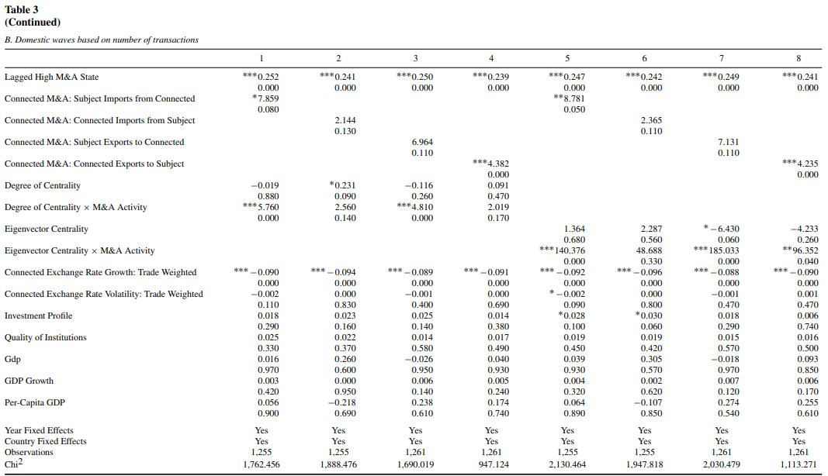
Notes:
Cross-border mergers are mergers between companies from different countries. For example, if a company in the U.S. acquires a company in Germany, that would be a cross-border merger.
Domestic mergers are mergers between companies from the same country. For instance, if two U.S. companies merge, that is a domestic merger.

Slide 21
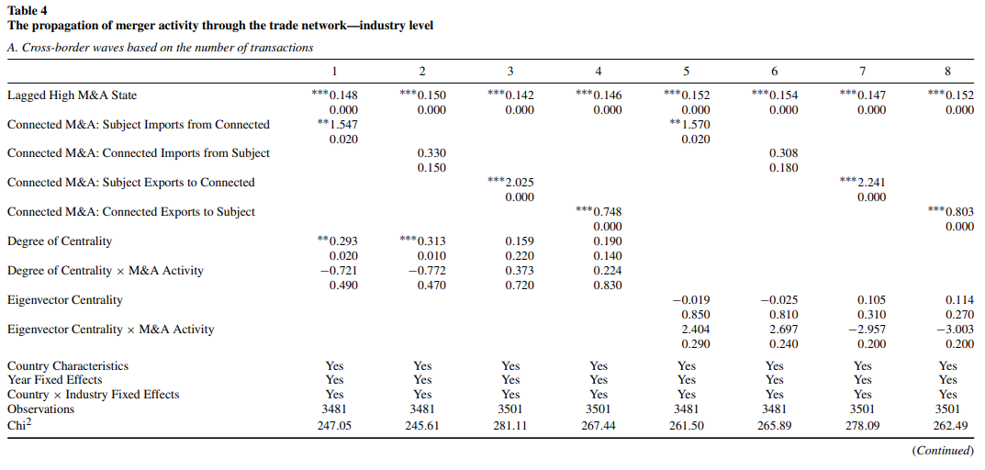
Notes:
Still significant, even when controlling for industry

Slide 22
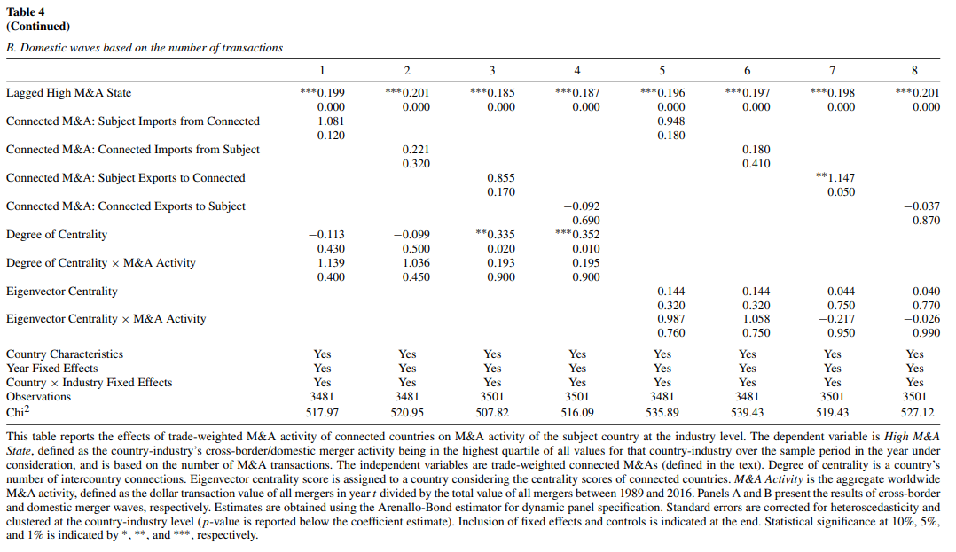

Slide 23
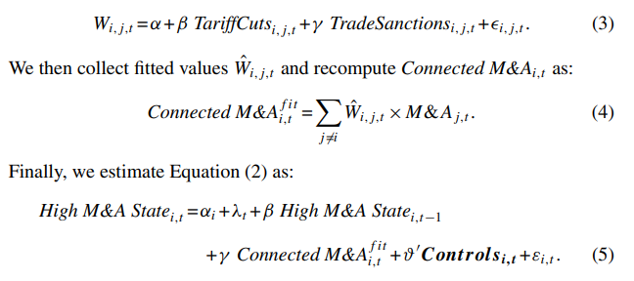
Table 5 – Instrument Variables
A 2SLS approach is taken.
The instruments are tariff cuts and trade sanctions
Notes:
Estimated W values are used to compute M&A, which is used to estimate High M&A State

Slide 24
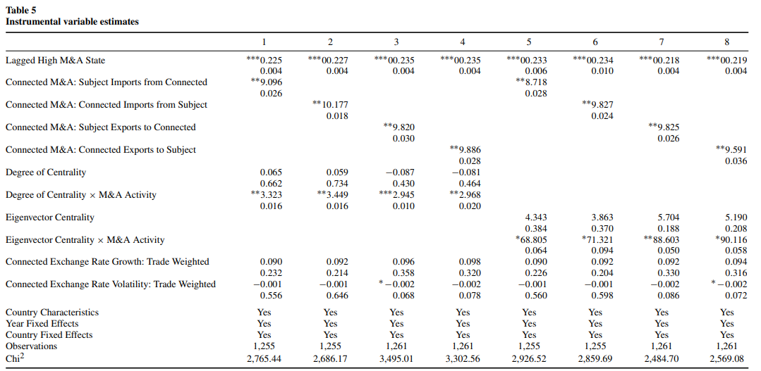
Notes:
Robust results, even with IV. Instrument is Tariff cuts and trade sanctions. Valid Instruments. All are statistically significant and positive

Slide 25
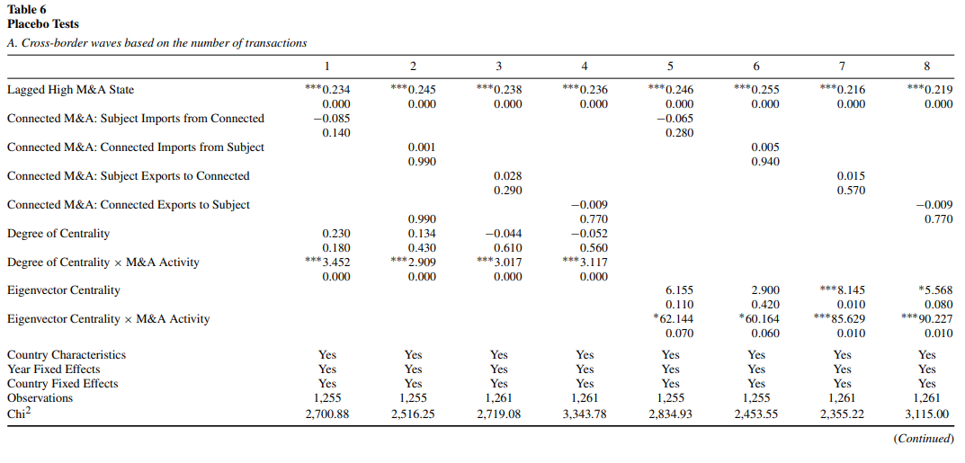
Notes:
Description: This table shows placebo tests where trade connections are randomly shuffled to verify the robustness of the trade-M&A link. Key Takeaways:
No Significant Correlations: The shuffled trade connections yield statistically insignificant results for most coefficients, confirming that actual trade flows are crucial for predicting mergers.
Supporting Number: P > 0.1
Trade-M&A Link Validated: The placebo test indicates that the trade link with M&A is not driven by random factors but genuine economic connections.
Supporting Number: Coefficients close to zero
Control for Endogeneity: These results strengthen the argument that the trade-M&A relationship is not endogenous.
Supporting Number: P-values all insignificant

Slide 26
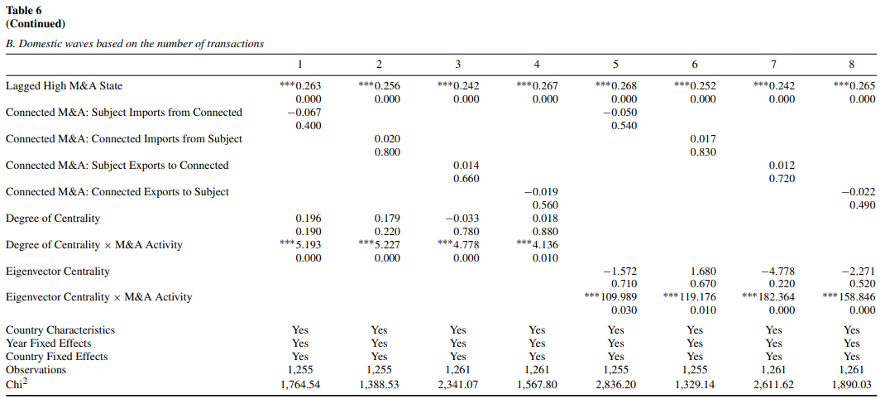

Slide 27
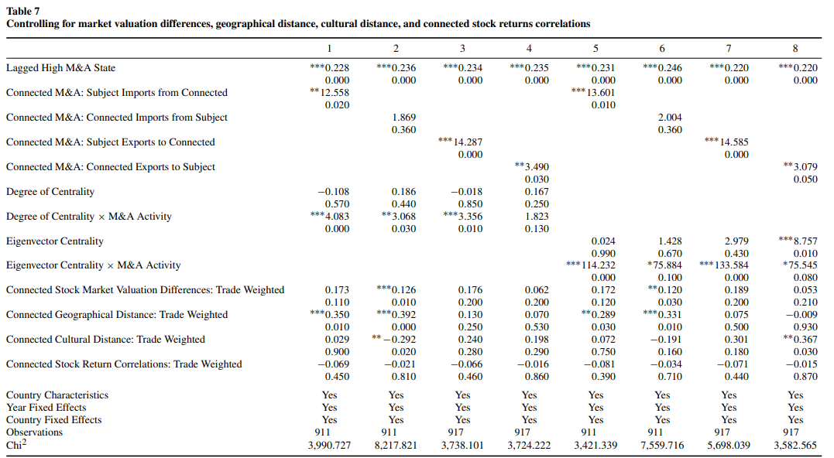
Notes:
Metrics are still positive and statistically significant despite robustness attempts. Adding 4 new variables to control for stock market, geographic distance, culture, and return correlations.

Slide 28
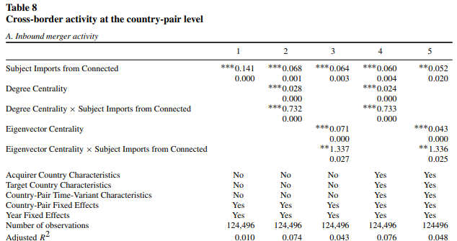
Notes:
Separates it into inbound and outbound mergers. It breaks this down into inbound mergers (when a company from a connected country buys a company in the subject country) and outbound mergers (when a company from the subject country buys a company in a connected country).
Strong Trade Flows Predict Mergers: Countries that trade more with each other are more likely to experience cross-border mergers. For example, an increase in imports from a trade partner predicts higher merger activity between the two countries.
Supporting Number: For inbound mergers, the coefficient for "Subject Imports from Connected" is 0.141.
Interaction Between Trade and Centrality: The relationship between trade and mergers becomes even stronger for countries that are more central in trade networks. Central countries with strong trade connections are more sensitive to changes in trade, meaning trade flows have a bigger impact on their merger activity.
Centrality positive and statistically significant

Slide 29
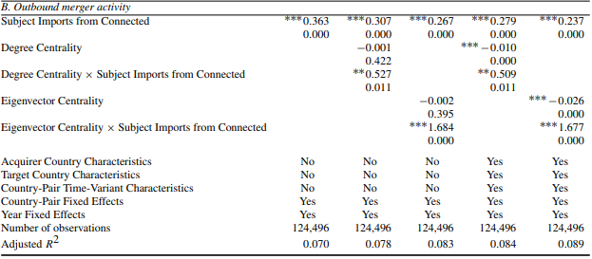

Slide 30
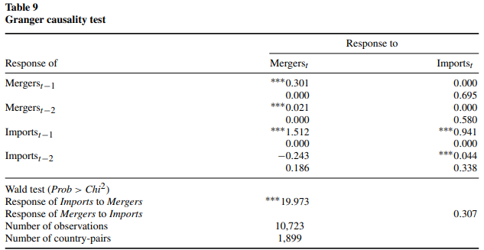
Notes:
Granger causality test to investigate whether trade flows cause cross-border mergers, or if mergers cause trade flows.
Specifically, it looks at whether past trade flows predict future mergers (and vice versa), using data for country pairs over time.
The Granger causality test shows that lagged trade flows significantly predict future merger activity. This means that if a country’s trade flows increase, it is likely to experience more mergers in the future.
Supporting Number: Coefficient for "Imports at lag 1" predicting mergers is 1.512.
Mergers Do Not Predict Trade Flows: The test finds no evidence that past merger activity predicts future trade flows. In other words, mergers do not seem to drive changes in trade between countries.
Supporting Number: Coefficient for "Mergers at lag 1" predicting imports is 0.000 (not significant).

Slide 31
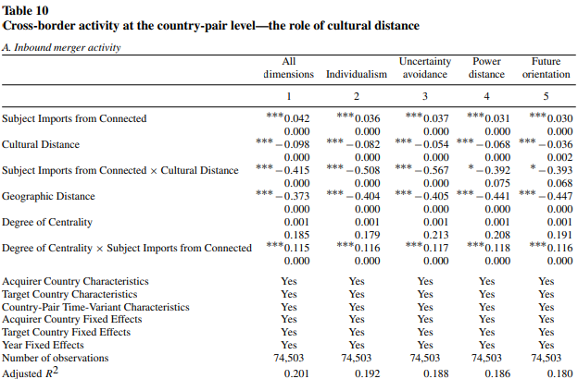
Notes:
Cultural distance has a negative impact on M&A activity. Both inbound and outbound.
, cultural distance weakens the effect of a given amount of trade on future cross-border activities Suggesting that business practices are shared less by different cultures

Slide 32
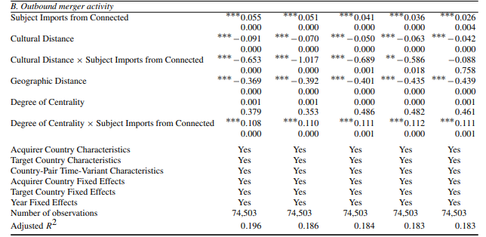

Slide 33
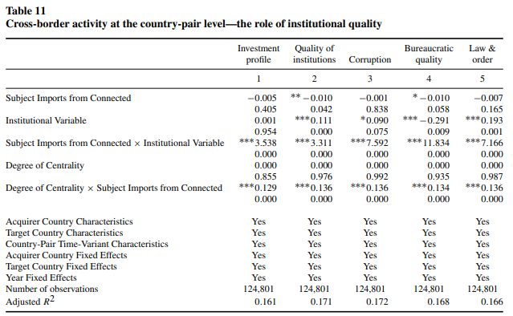
Notes:
Higher number means better, so in this case lower corruption

Slide 34
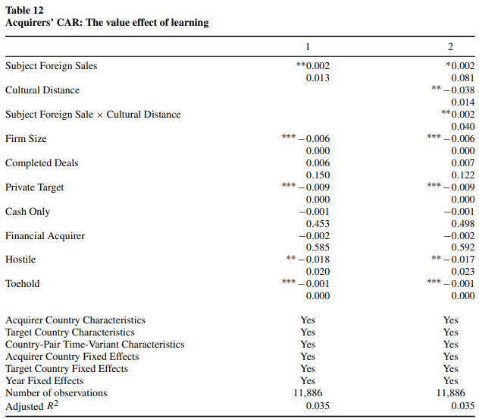

Slide 35
Conclusion
Trade Drives Cross-Border Mergers: Countries with stronger trade relationships are more likely to experience cross-border mergers, as trade flows facilitate economic connections and business opportunities across borders.
Central Countries Absorb More Mergers: Countries that are central in the global trade network tend to attract more inbound mergers, while originating fewer outbound ones, reflecting their strategic importance in the global economy.
Trade’s Role in M&A Propagation: The intensity of trade flows between countries significantly predicts the spread of merger waves, highlighting the global interconnectedness of merger activity and its link to international trade dynamics.

